Slide 1

Atop Import and Export Trading Co.,Ltd

Slide 2
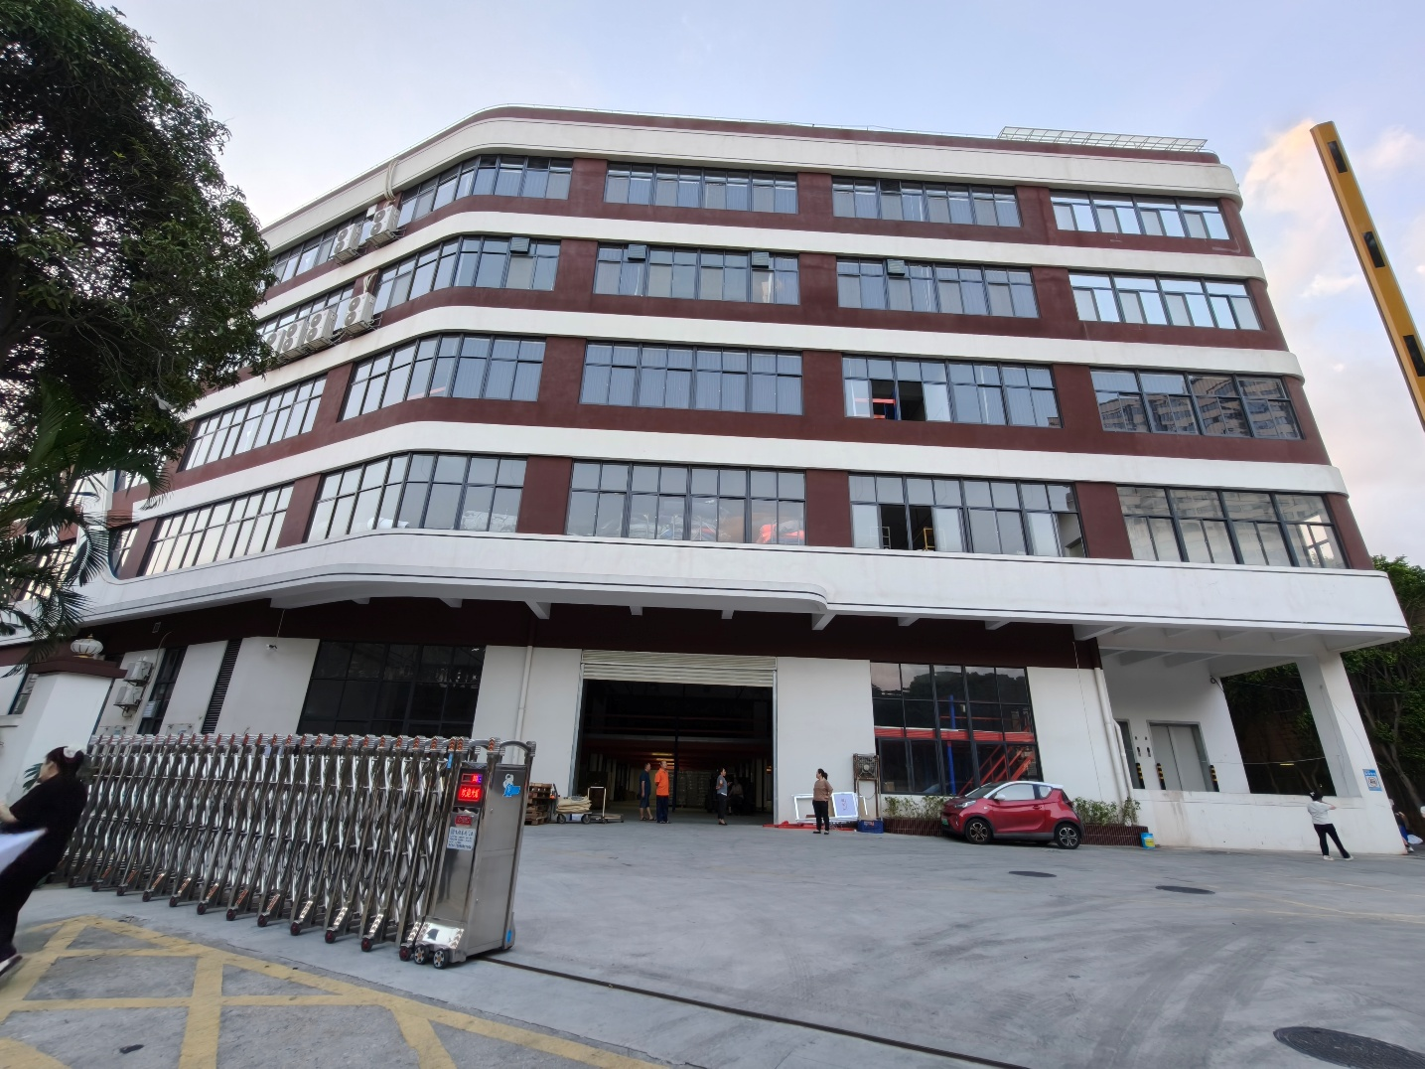
Atop Import and Export Trading Co.,Ltd
Professional Beauty & Personal Care
Manufacturer
Founded in 2000, with 20+ years of profound industry experience in personal care manufacturing
Headquarters in Xiamen, China – a key global trade hub
Two modern complexes (32,000 M²) integrating offices & production facilities
Core focus: Customized ODM/OEM services for personal care & bath products
Trusted by 600+ companies worldwide with long-term partnerships.

Slide 3

About Atop
Company History
Develop
Our company was founded in 2000. In the initial stage, we mainly engaged in OEM production and export of soap petals and bar soap products.
2000
Nowadays, Atop has established long-term cooperative relationships with over 600 companies worldwide.
2016
In 2016, our company expanded the scale of our production line and began construction projects for a new factory area
2025
We have a 32000 square meter modern factory, with excellent product quality and years of deep cultivation, we’ve gradually grown our scale, and have expanded the business to various types of beauty and personal care products.

Slide 4
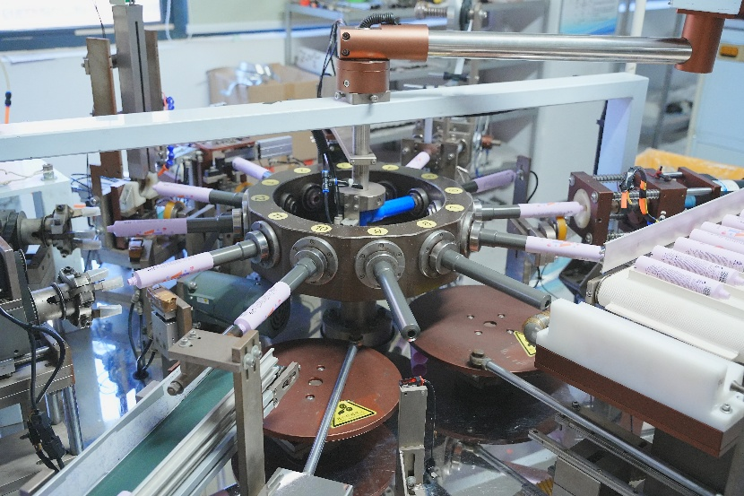
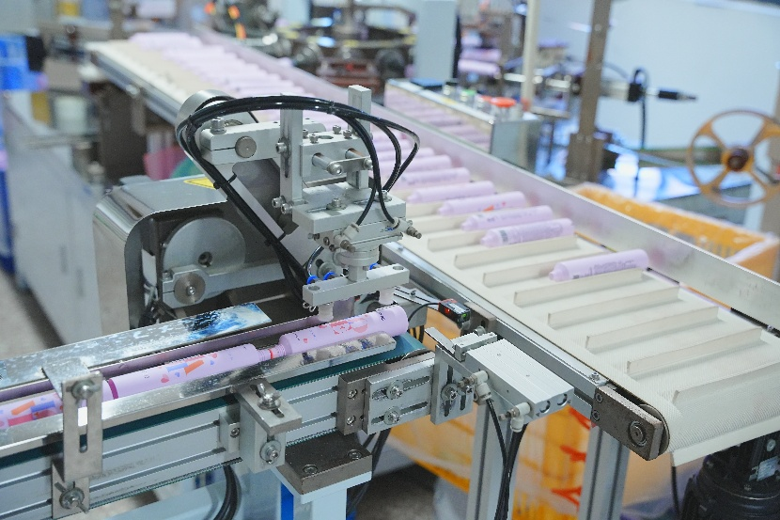
Production Capacity
Core Data
32,000
M²
80M+
100%
Factory
Annual Capacity
Automation
Advanced Production Facilities
Modern Production Lines
9 automated production lines, adopting the latest automated production technologies for efficiency and precision.
Quality Control System
Implementing full-process monitoring to ensure consistent product quality.
Efficient Logistics Management
Optimized supply chain to guarantee timely delivery of products.

Slide 5
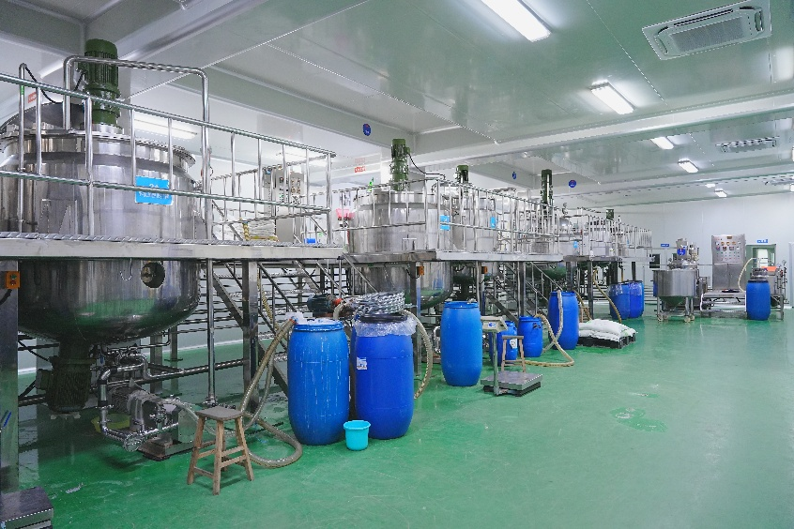
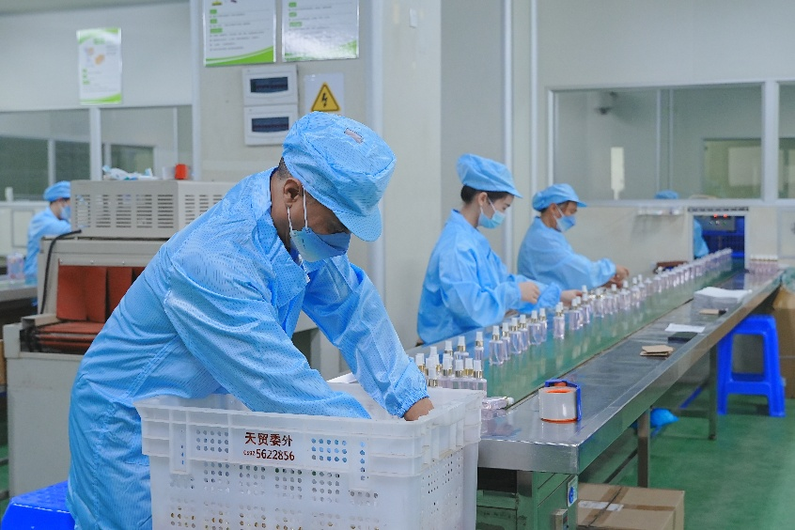
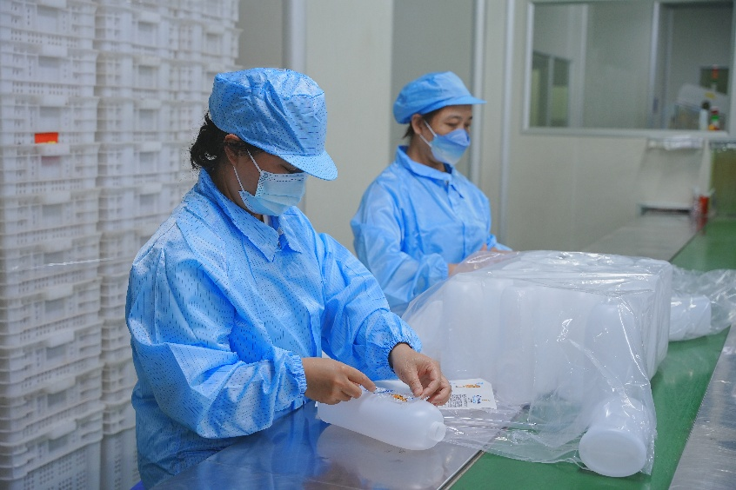
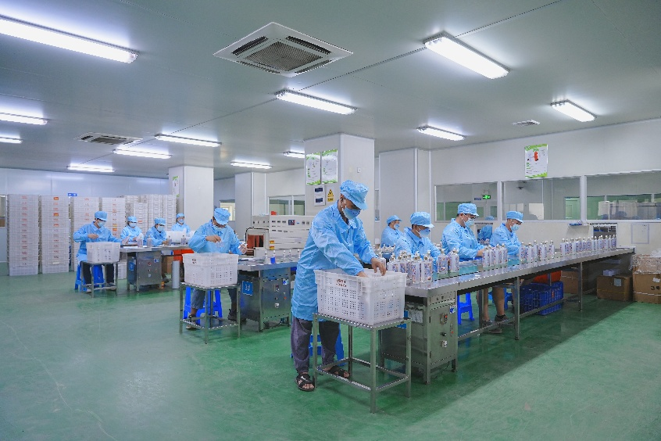
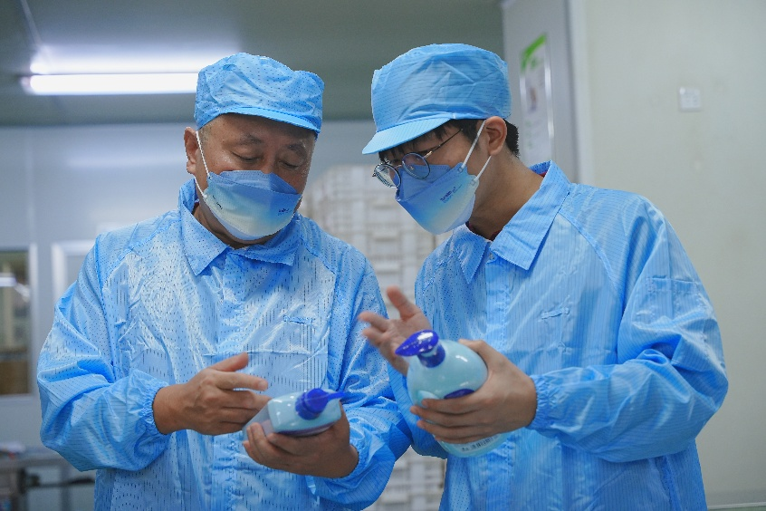
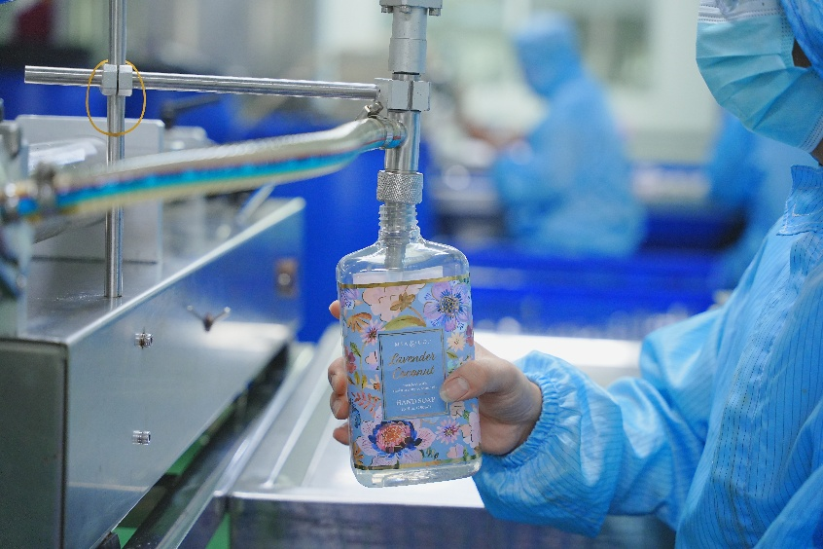
Filling Workshop

Slide 6
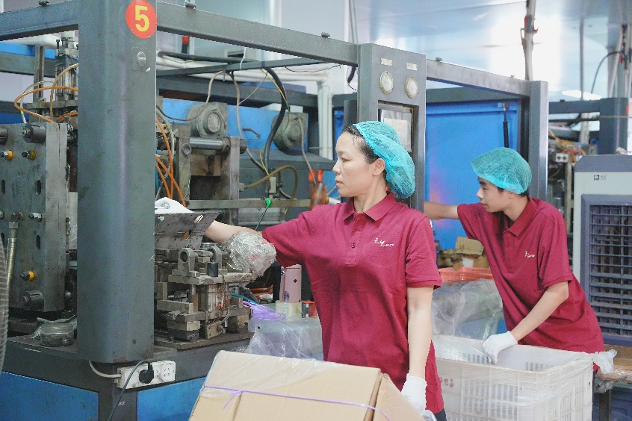
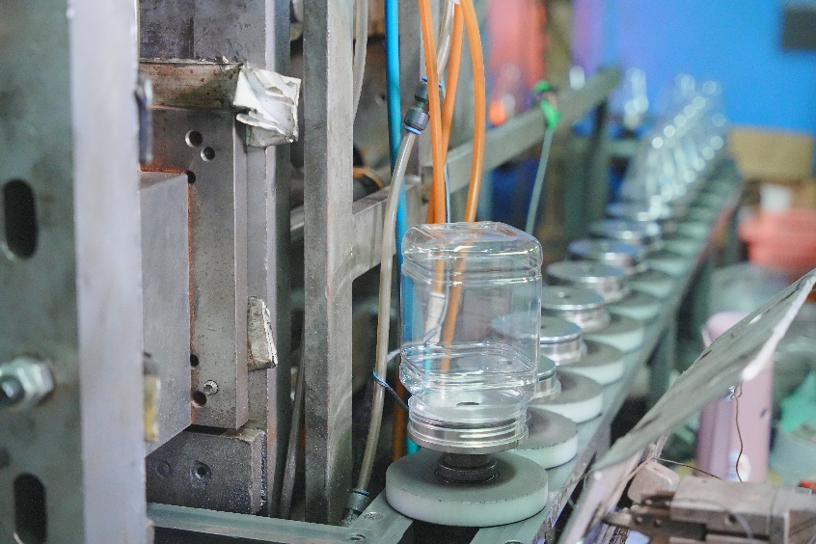
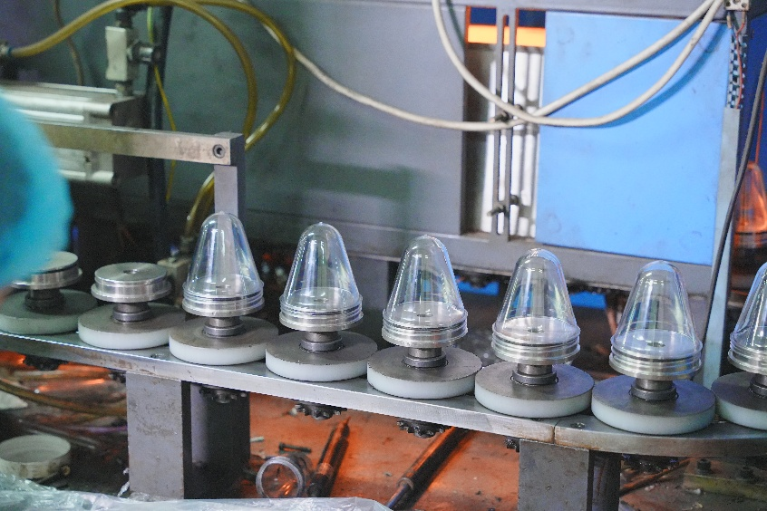
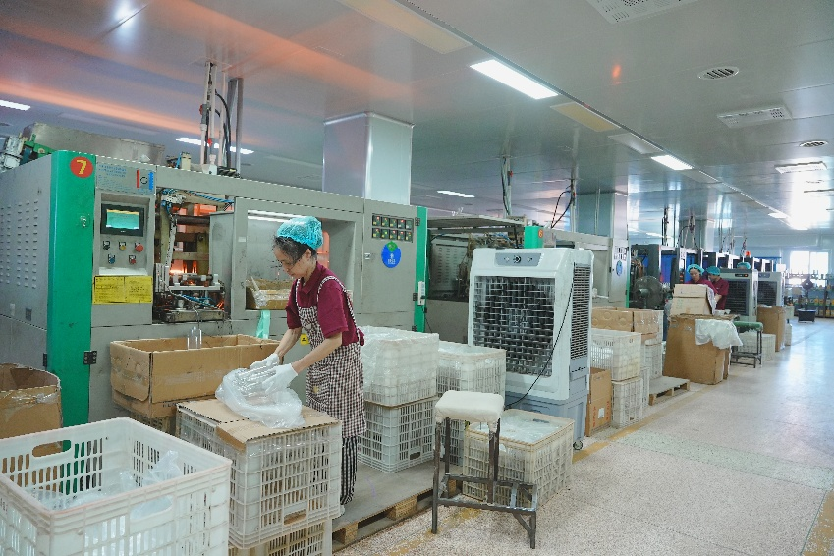
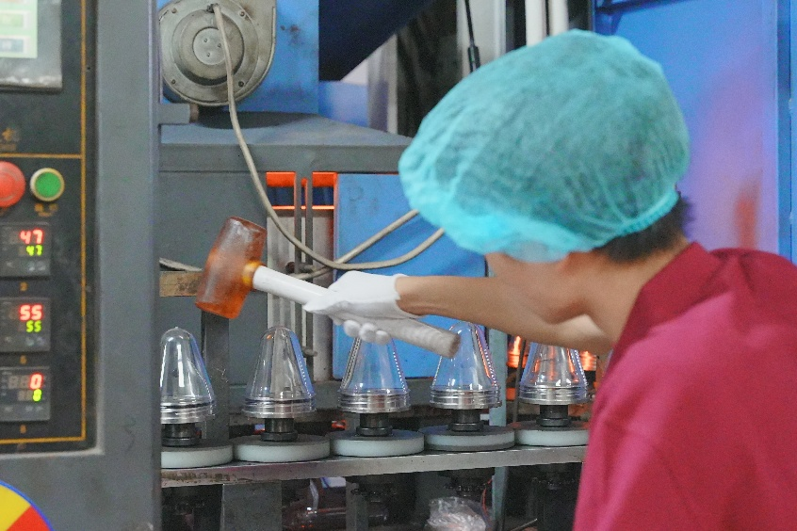
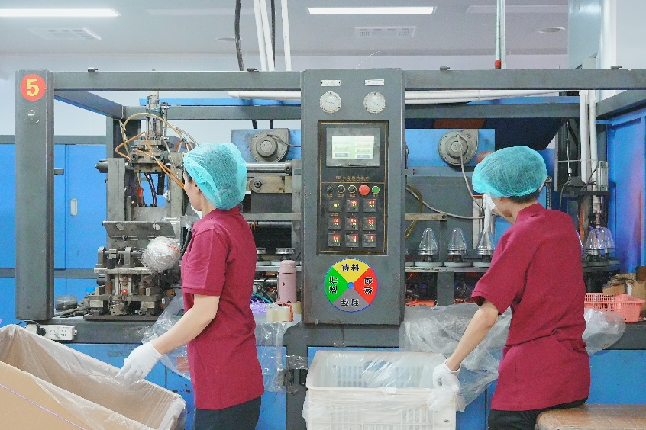
Bottle Workshop

Slide 7
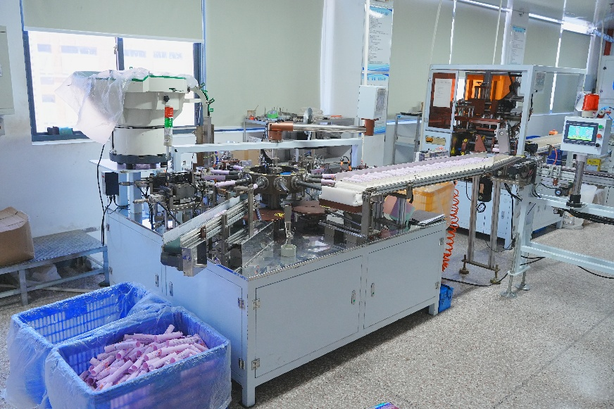
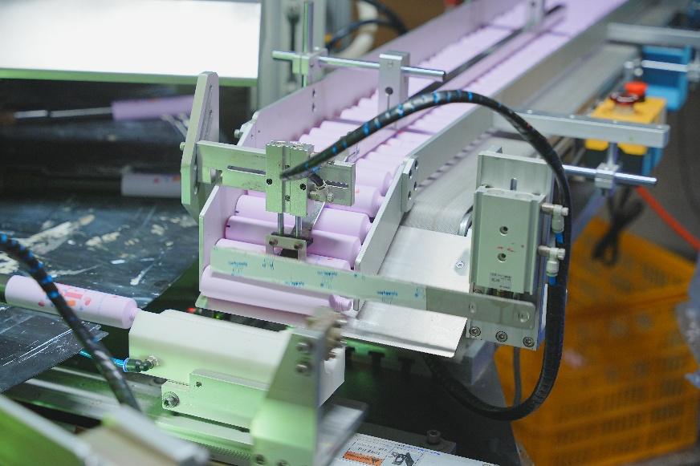
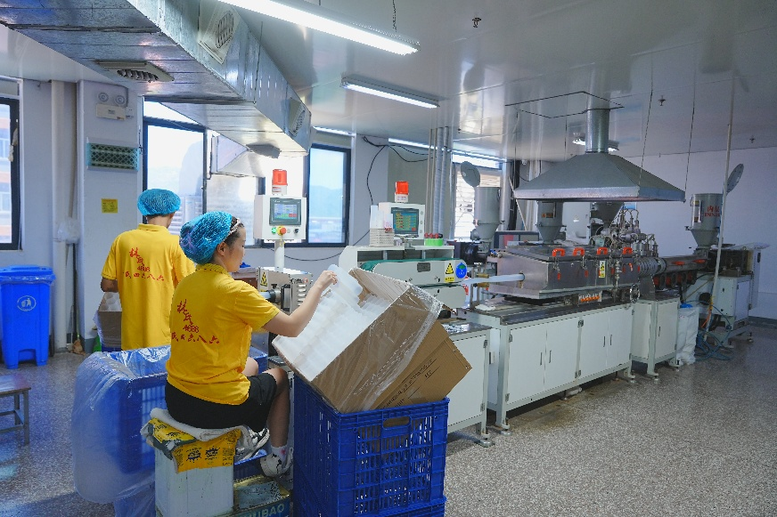
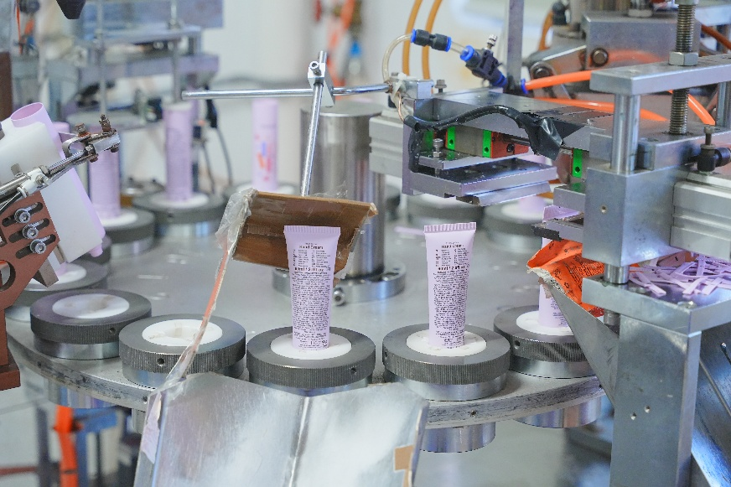
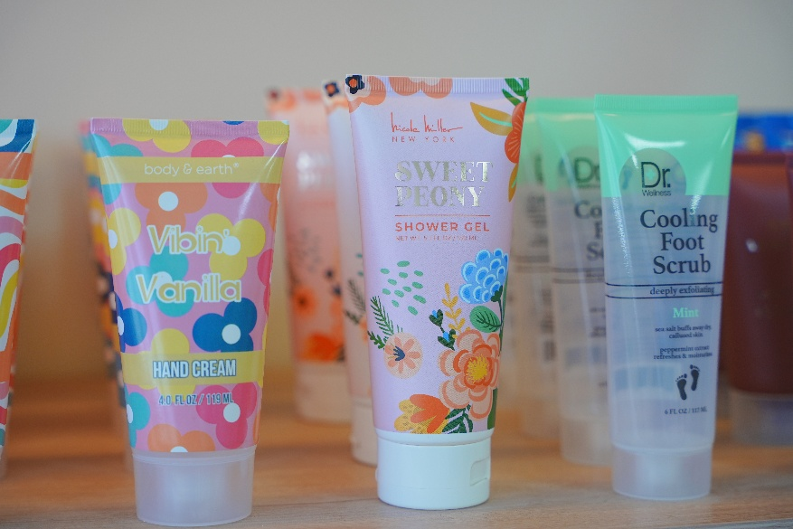
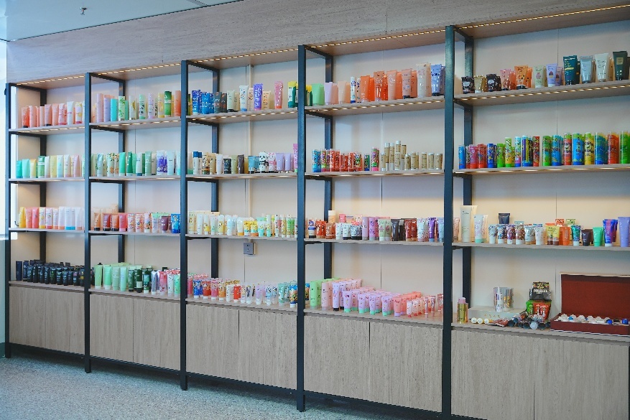
Tube Workshop

Slide 8
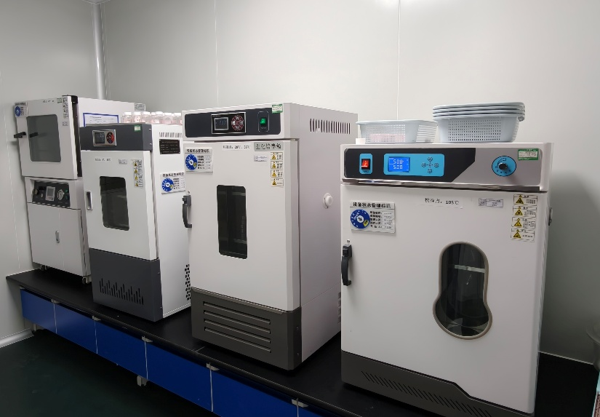
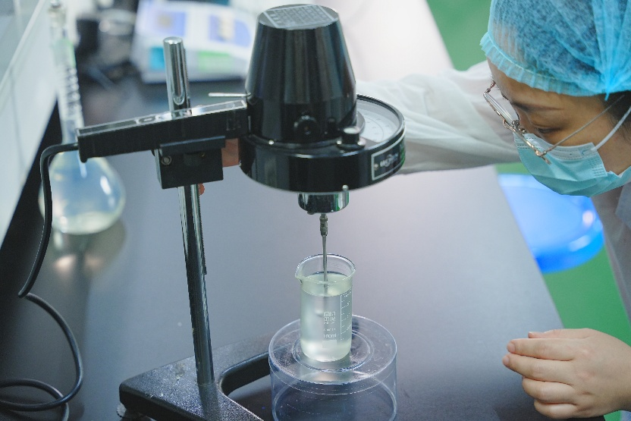

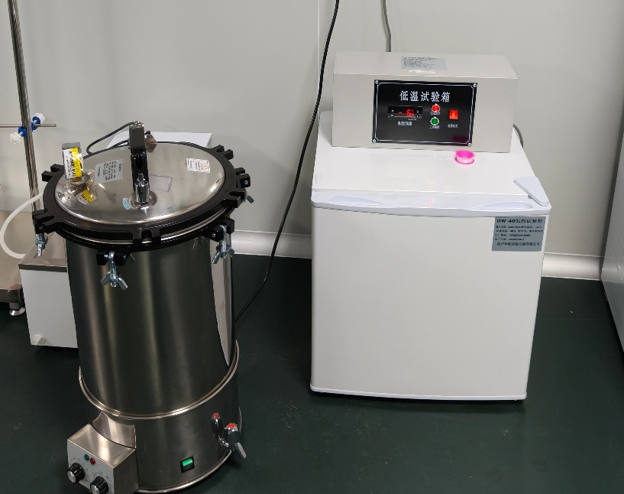
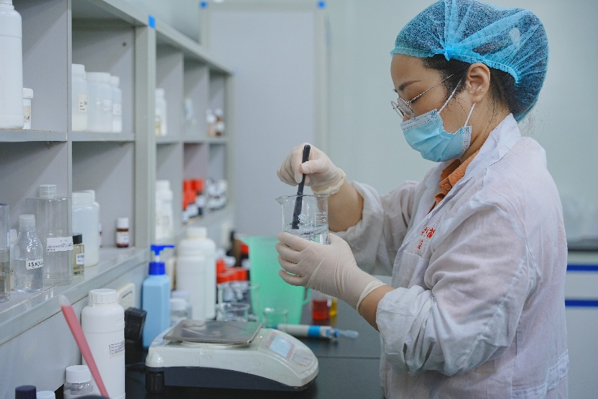
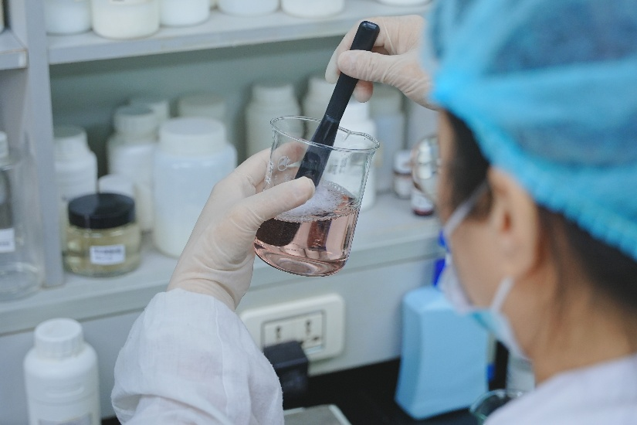
Laboratory

Slide 9
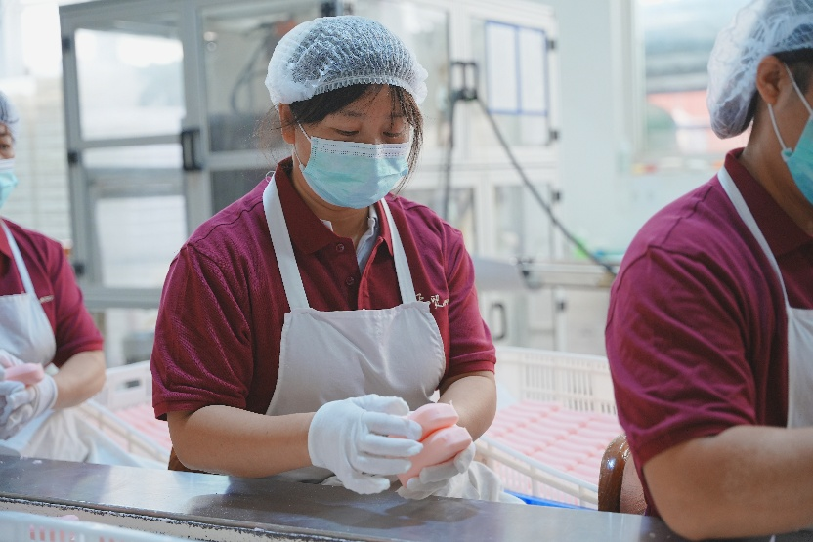
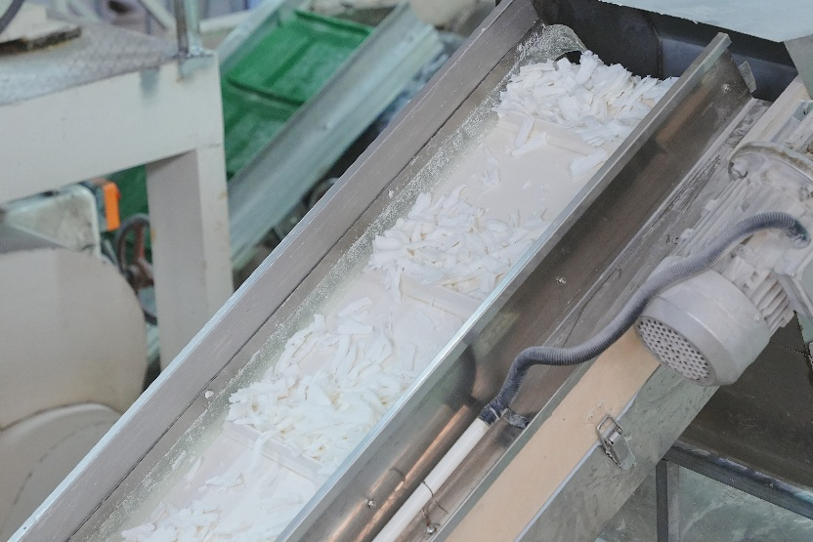
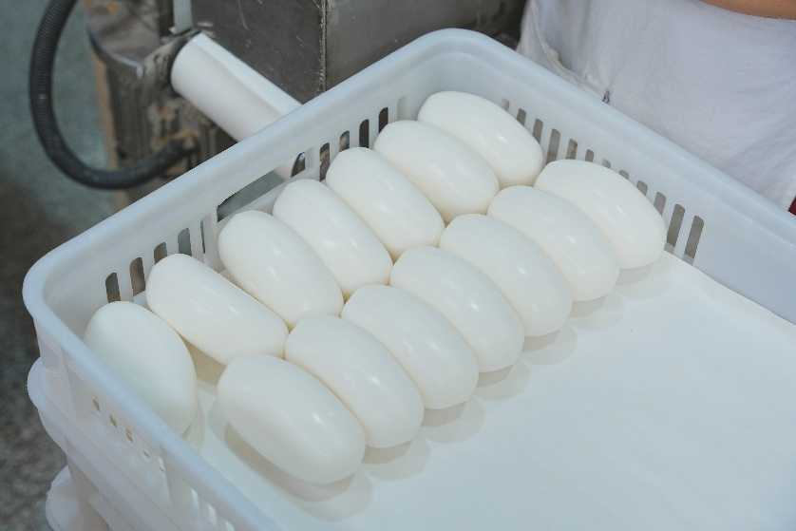
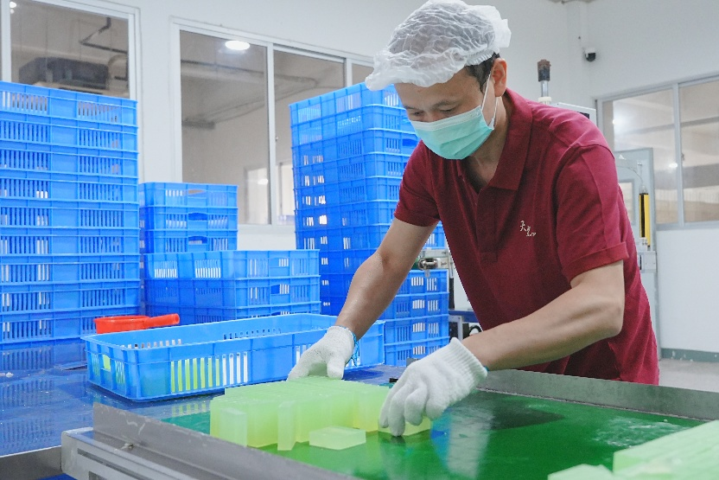
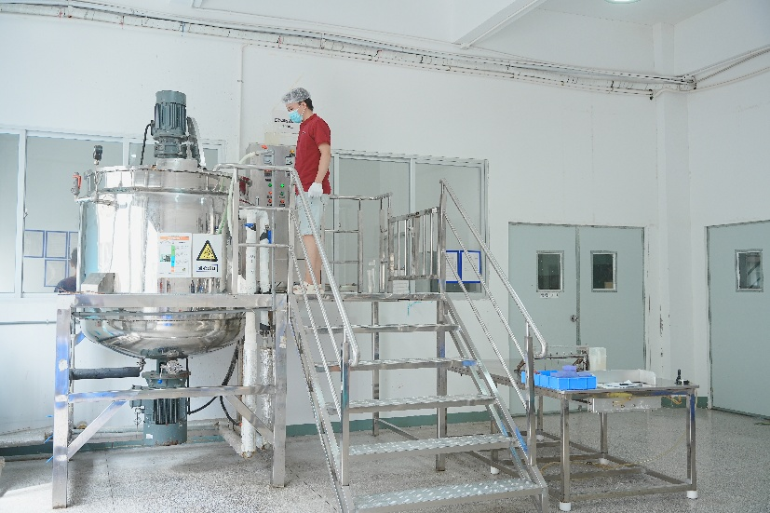
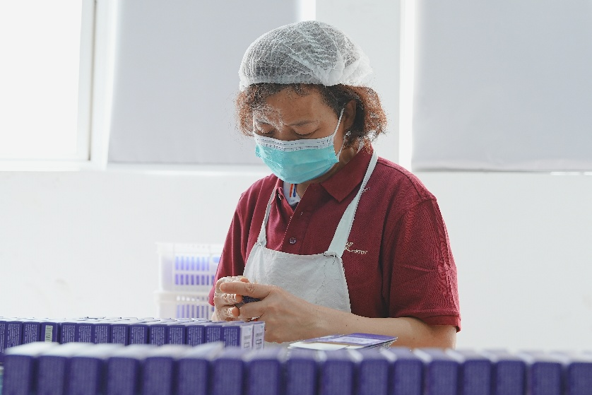
Soap Workshop

Slide 10
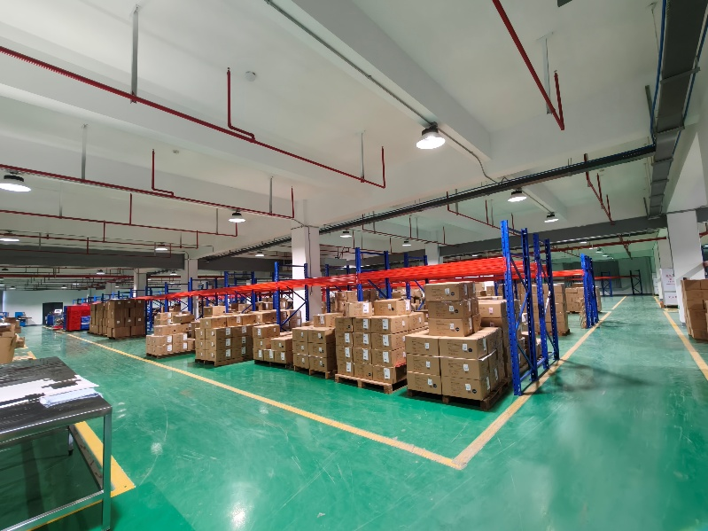
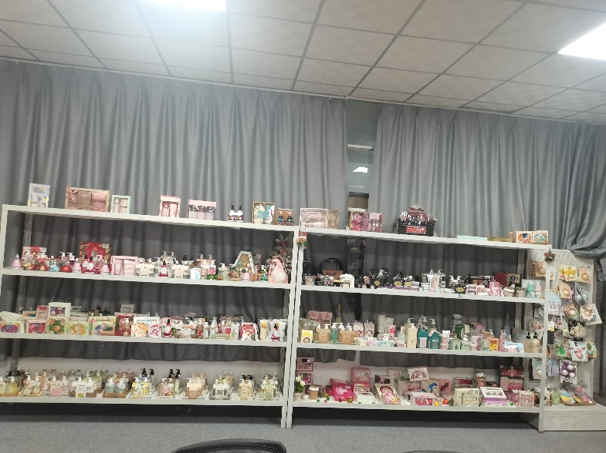
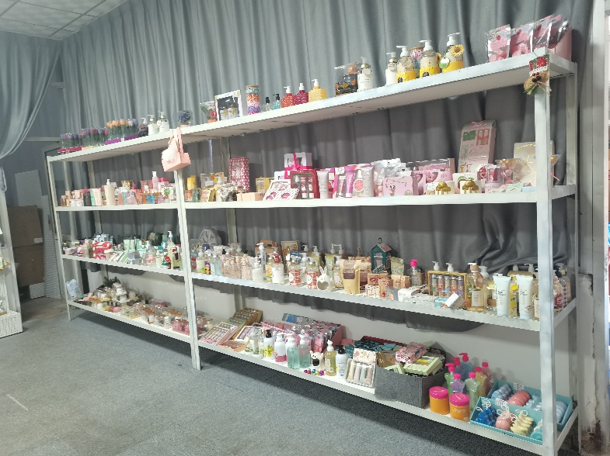
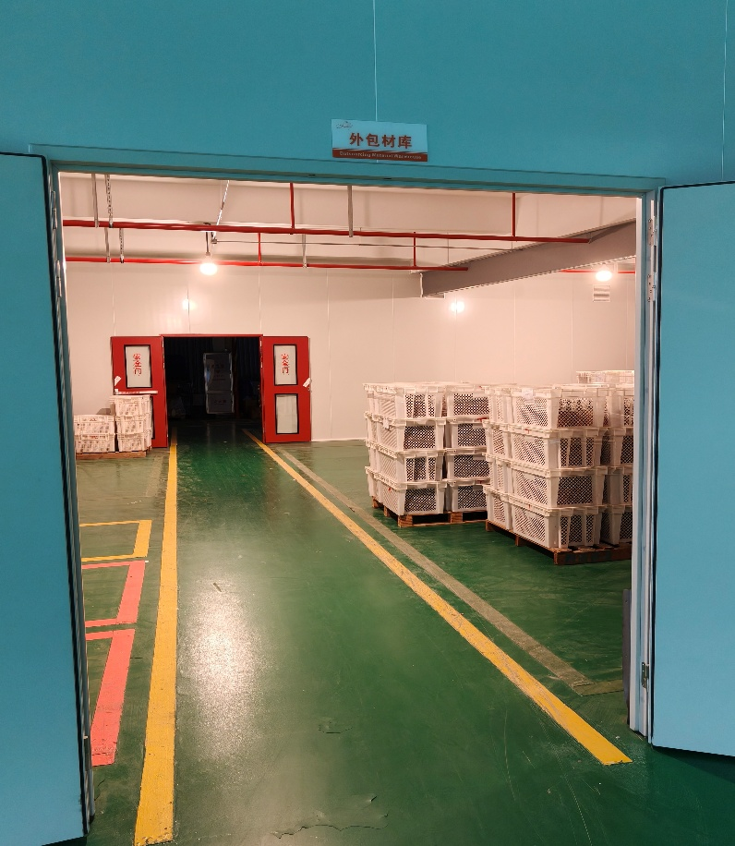
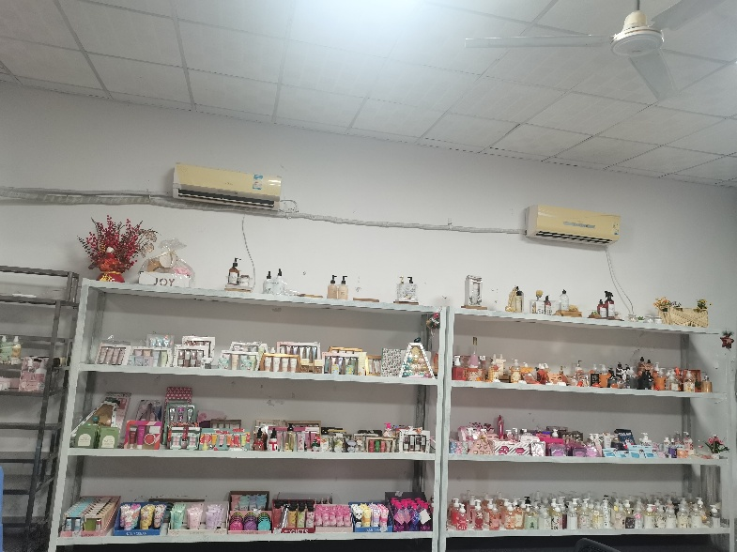
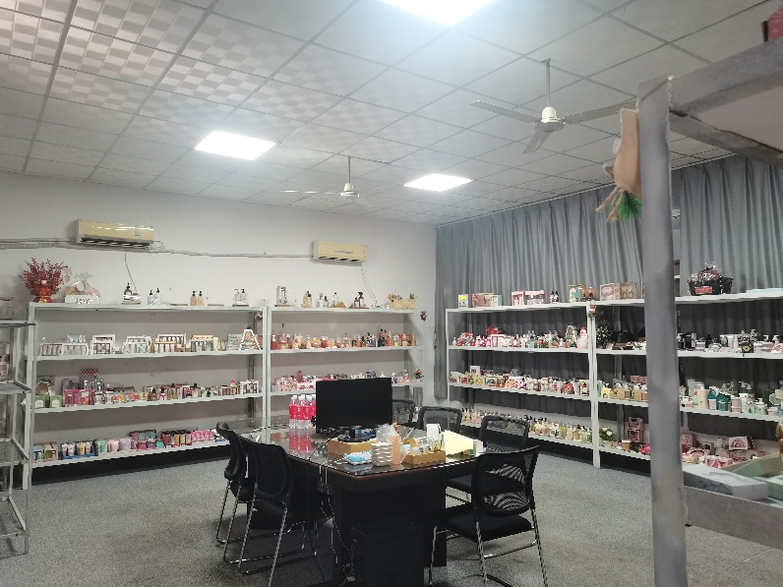
Show Room & Warehouse

Slide 11
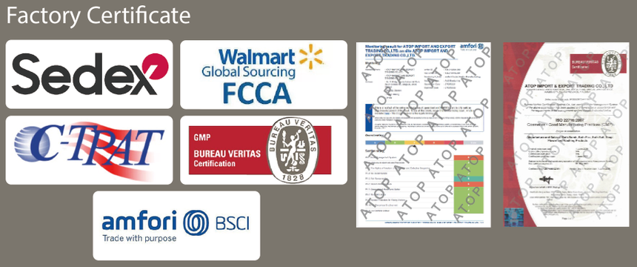
Quality Certifications
Professional
Third-party
QA Process
Certifications
Verification
BSCI
GMPC
CTPAT
BV
Bureau Veritas
All products undergo strict laboratory testing before leaving the factory.
QIMA
SEDEX
SGS
SGS Group
1
Third-party sampling certification is entrusted to authoritative institutions such as BV or SGS for sampling certification.
2
The full-process quality monitoring is a quality control system covering the entire process from raw materials to finished products.
3

Slide 12
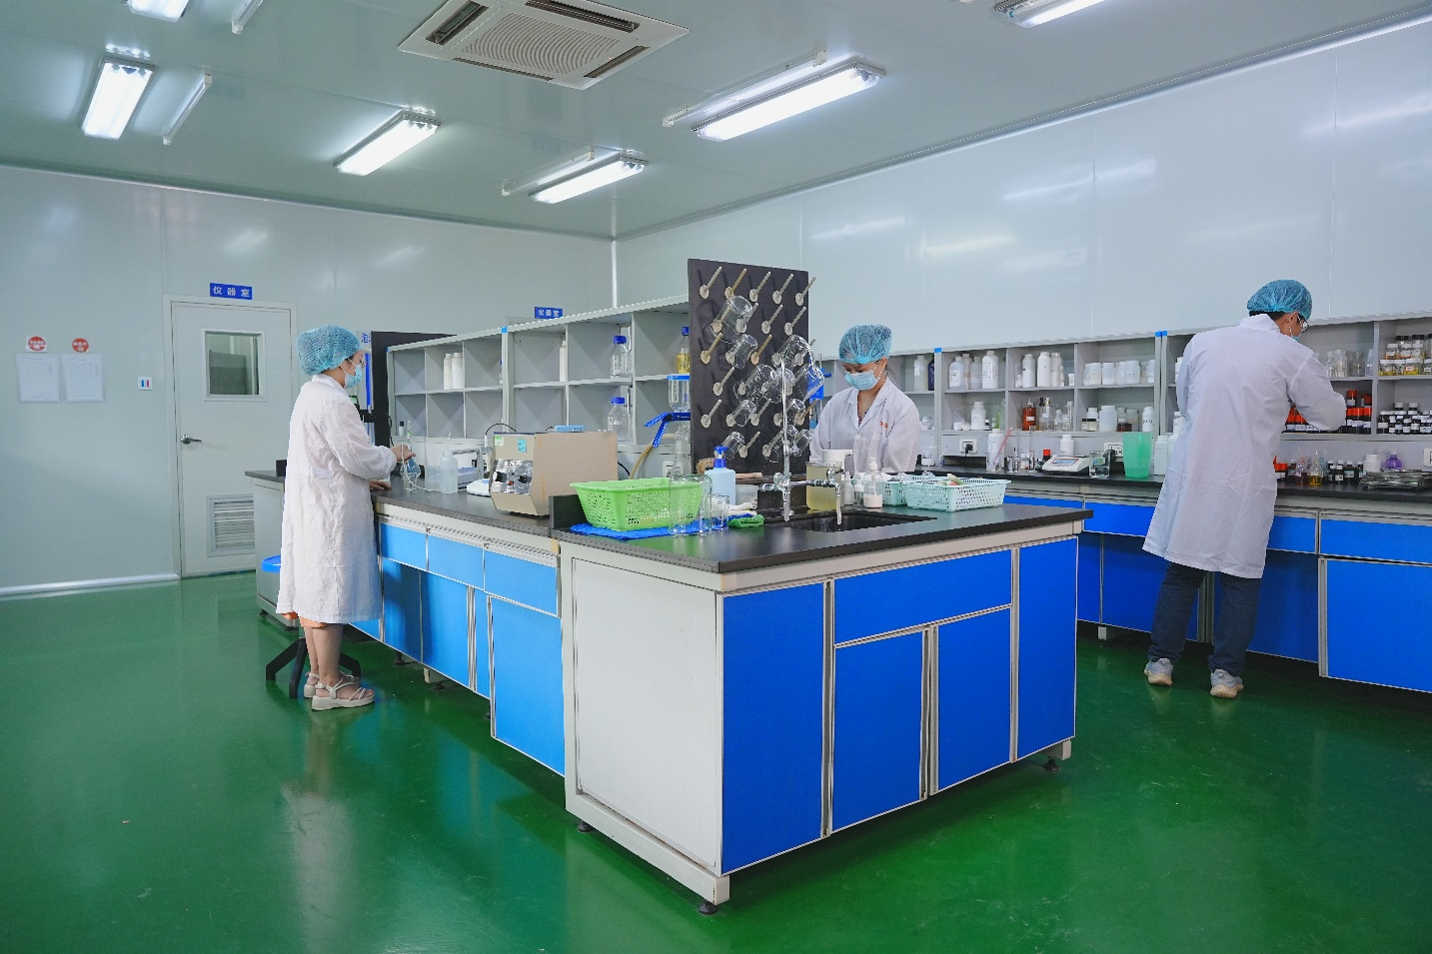
R&D Capabilities
Professional R&D Team
Dozens of precision instruments, multiple sterile laboratories, PhD-level engineers.
Standardized Laboratory
Equipped with inspection-standard laboratories to
ensure product quality and safety.
Continuous Innovation
Relying on advanced equipment for ongoing product
innovation and technological upgrades.

Slide 13




Product Range
Comprehensive Beauty & Personal Care Products
Bath Salts
Body Washes
Hand Soaps
Hand Creams
Bar Soaps
Eye Masks
Body Scrubs
Serums
Our Specialized Services
Custom Formulations
Diverse Selection
We offer personalized product
to meet unique client
A rich variety of products to
satisfy a wide range of market

Slide 14
Our Advantages
Why Choose Us as Your Partner
Core Advantages
Service data statistics
Over 20 Years of Industry Experience
Strict Quality Assurance
600+
Extensive experience in manufacturing beauty and personal care products, with deep understanding of market demands and trend changes
Perfect quality management system, multiple certification guarantee, to ensure the stability and reliability of product quality.
Successful projects
99.8%
Competitive Pricing
Timely Delivery Assurance
Customer Satisfaction
Large-scale production reduces costs and provides customers with competitive pricing solutions.
Efficient production management and logistics system to ensure timely completion and delivery of orders.
24/7
All weather Service
100+
Professional service team
OEM/ODM Service
Our experienced professional team provides a full range of services from product development to after-sales service.
Provide customized manufacturing
Professional Staffs

Slide 15
Let's Start Our Partnership Journey
Contact Us
Mobile Phone:
+86-18060958277
Atop Import and Export Trading Co.,Ltd
Professional Beauty & Personal Care
E-mail:
atop@atopco.com
Address: No.6 Guangxing South Rd, Jimei District, Xiamen, Fujian Province, China.
Thank You for Your Attention

